Slide 1

Online Theater Booking Process Analysis and Improvement
Presented by Group 7:
Nikhil, Maisha, Raghav, Rahul, Somya

Slide 2

Introduction
Steps inefficiencies, and improvements.

Slide 3
Detailed Process Description
Business Process: Online Theater Booking
Customer Initiation:
Customer decides to book a theater ticket online and visits the booking website or app.
Browsing and Selection:
Customer logs in or creates an account.
Enter locations
View available theaters
Browses available movies or shows.
Selects a movie or show, date, and time.

Slide 4
Detailed Process Description Con.
Seat Selection:
Views the seating layout.
Selects desired seats and reviews them.
Payment Process:
Proceeds to checkout.
Enters payment details and reviews the order.
Confirms the booking and makes the payment.
Booking Confirmation:
System processes the payment.
Confirmation details are sent via email or app notification.

Slide 5
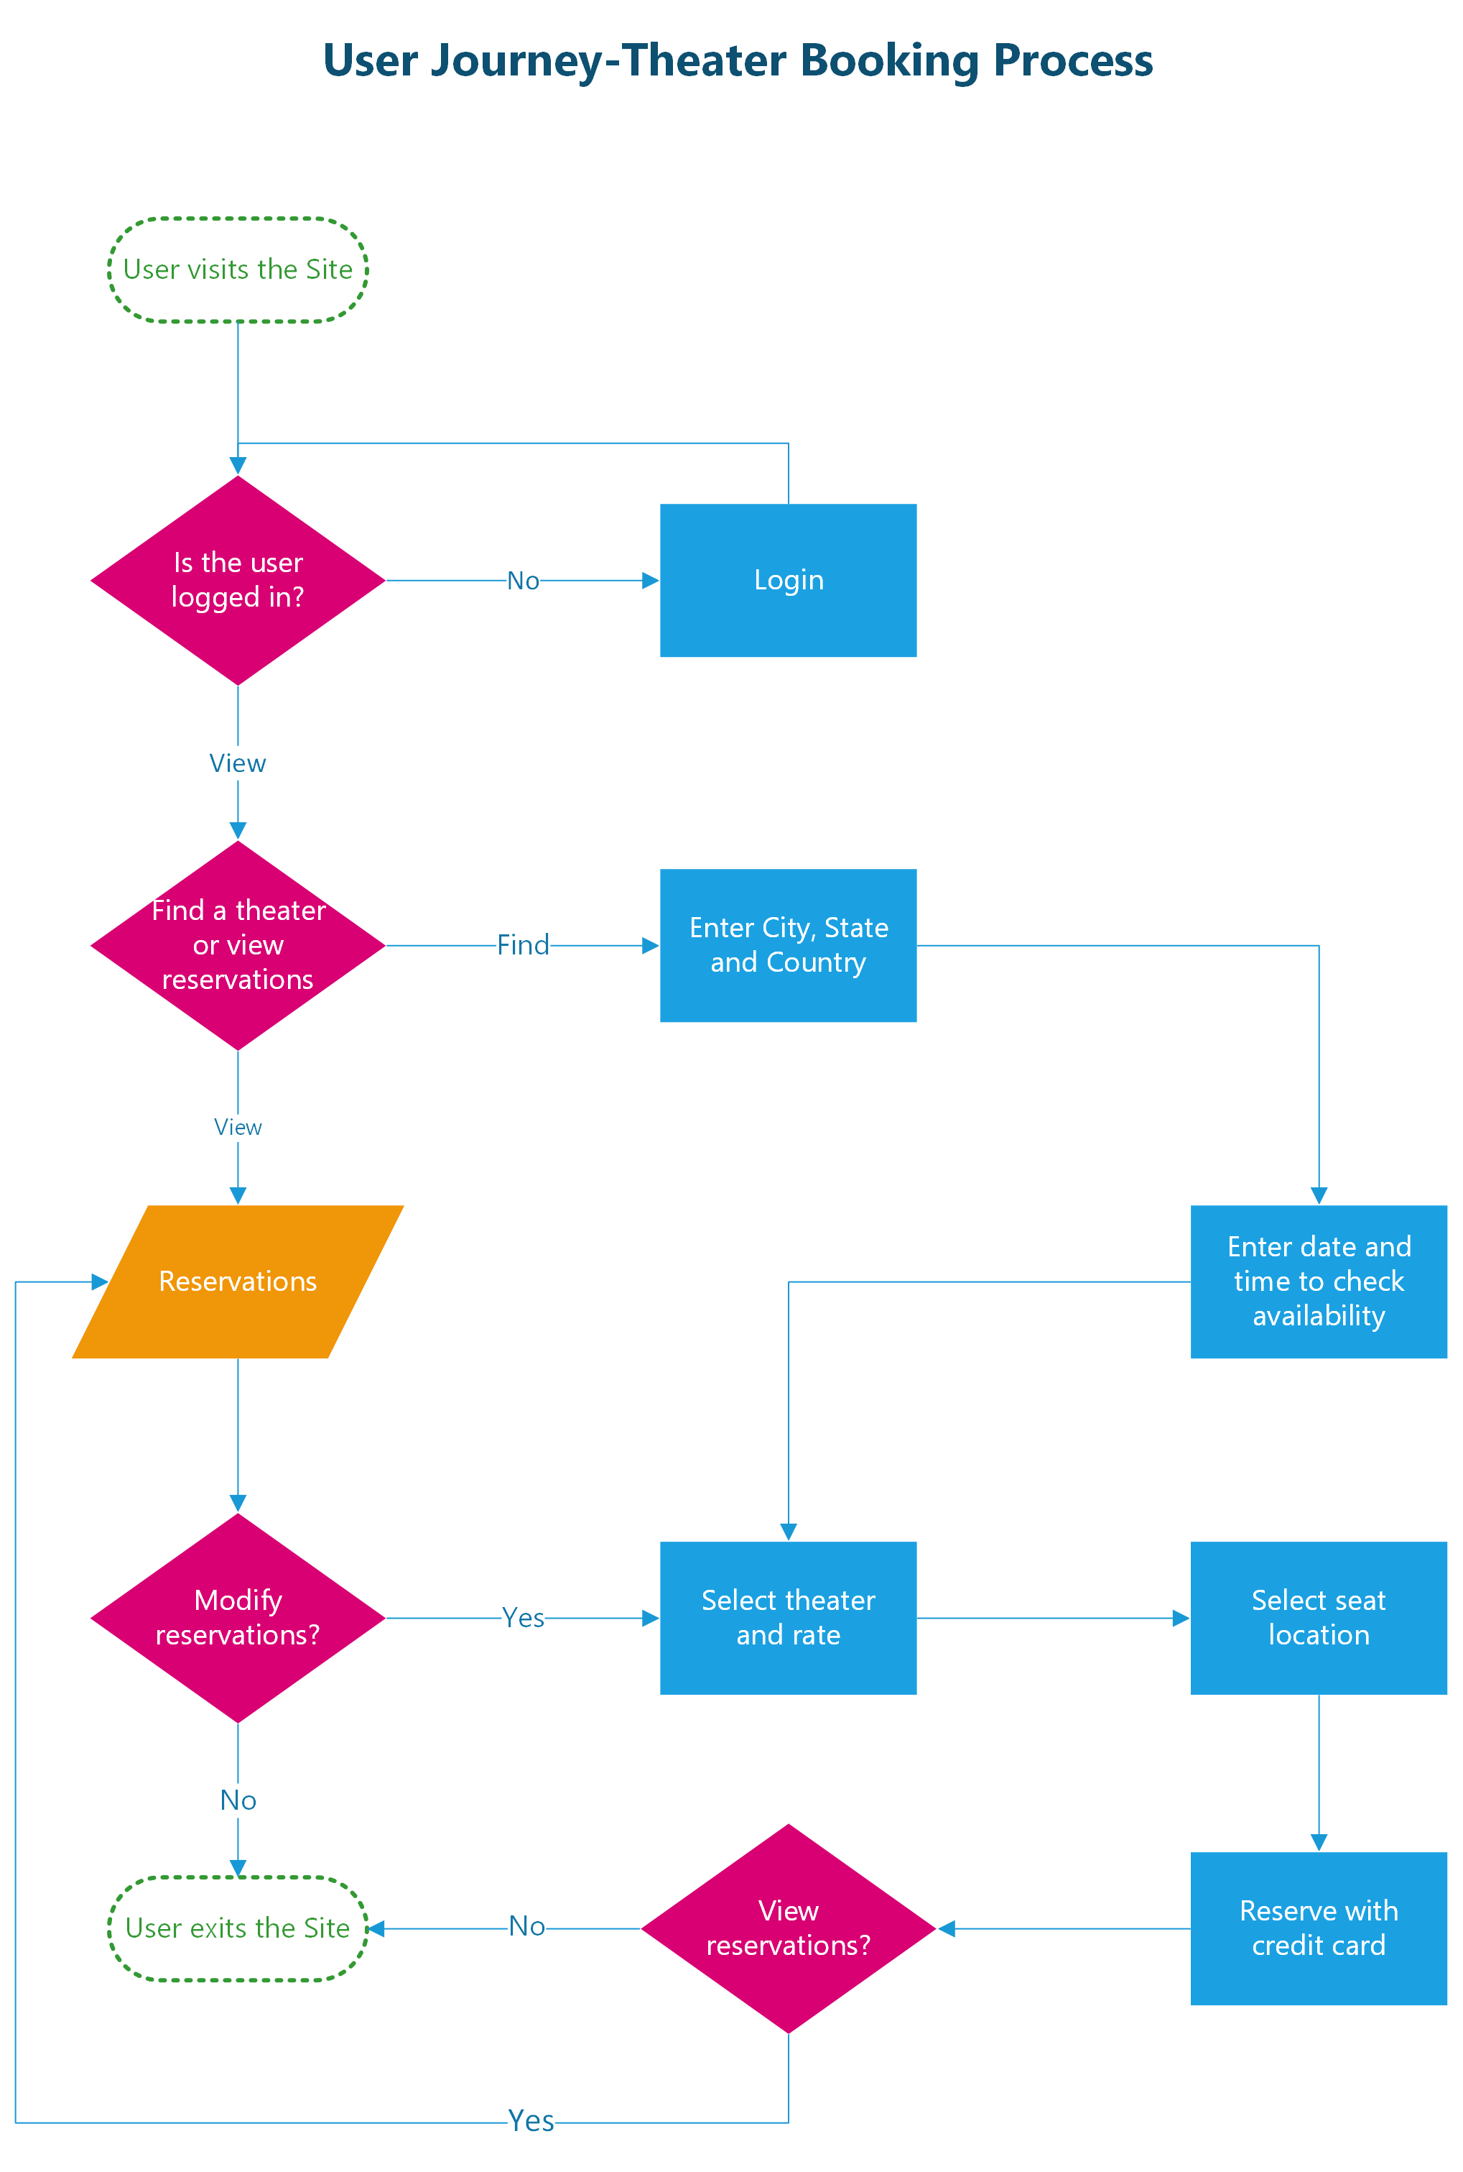
Process Flowchart

Slide 6
Process Analysis Bottlenecks and inefficiencies
Analysis of the Process Flowchart
Bottlenecks and Inefficiencies:
Account Creation/Login:
Time-consuming for new users.
Possible issues with password recovery.
Seat Selection:
Delays in loading seating layout.
Difficulty visualizing available seats.
Payment Process:
Potential payment gateway delays.
Complex checkout process leading to cart abandonment.

Slide 7

Improvement Suggestions
Streamlined Account Creation/Login:
Implement social media login options for quick access. For instance, allowing users to log in using their Google or Facebook accounts can significantly reduce the time taken to access the platform.
Improve password recovery process by offering instant recovery options such as SMS or email verification codes, making it easier for users to regain access to their accounts quickly.
Enhanced Seat Selection:
Optimize seating layout for faster loading times by using efficient data retrieval methods and reducing the amount of graphical data loaded simultaneously.
Implement 3D visualizations of seating arrangements to help customers better understand the layout and make more informed decisions. This can include a virtual tour of the theater, showing views from different seats.
Simplified Payment Process:
Offer multiple payment options including digital wallets like PayPal, Apple Pay, and Google Wallet, to cater to a wider range of customer preferences.
Implement a one-click checkout for returning customers by securely storing their payment and booking information, reducing the steps required to complete a transaction.
Ensure robust and secure payment gateways by partnering with reliable payment service providers and conducting regular security audits to protect customer data.

Slide 8
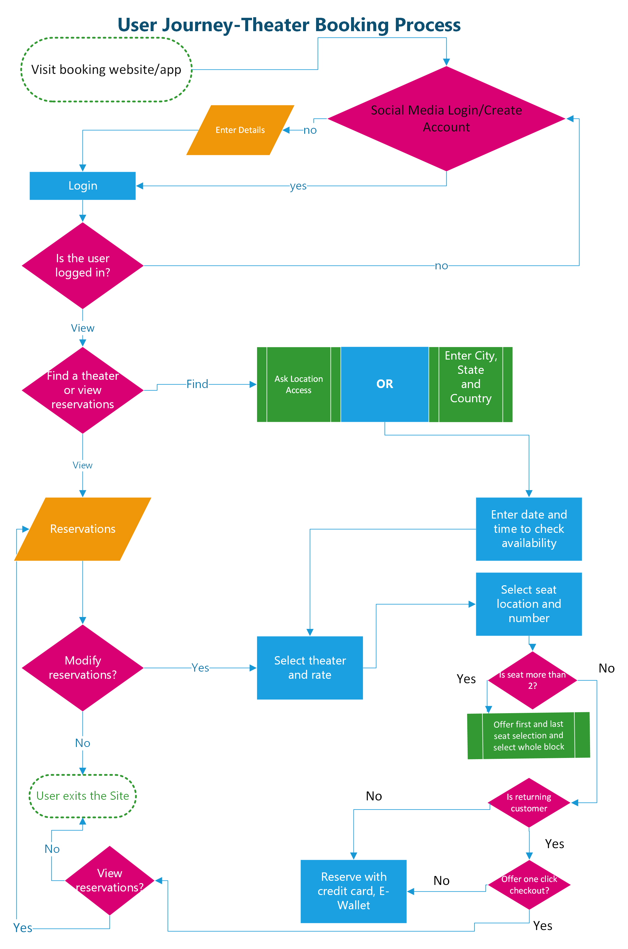
Improved Process Flowchart

Slide 9

Summary
Summary of Findings and Improvements
Recap:
Detailed the online theater booking process.
Created a flowchart to visualize the steps.
Analyzed inefficiencies in the current process.
Suggested improvements to streamline the process.
Expected Benefits:
Enhanced efficiency in booking tickets due to faster account access and seat selection.
Improved customer satisfaction from a smoother booking experience and more payment options.
Overall better customer experience and operational performance for the theater.

Slide 10
Conclusion
Implementing these improvements can significantly enhance the theater booking experience, making it more user-friendly and efficient.
Thank you for your attention.
We are now open to any questions you may have.

Slide 11

Q&A

